Slide 1
Perception, Reasoning, Action:
The New Frontier of Embodied AI
Federico Landi
Tutor: Prof. Rita Cucchiara
Coordinator: Prof. Sonia Bergamaschi
25/03/2022

Slide 2
Embodied AI
Embodied AI is a new research area that aims to bridge recent findings in AI and Computer Vision to create intelligent and autonomous agents capable of interacting with the surrounding environment

Slide 3
Embodied AI
Embodied AI is a new research area that aims to bridge recent findings in AI and Computer Vision to create intelligent and autonomous agents capable of interacting with the surrounding environment
Enabled by recent availability of:
Datasets of 3D spaces: Matterport3D (2017), Gibson (2018), Replica (2019), …
Simulation softwares: MP3D Simulator (2018), Habitat (2019), …

Slide 4
Embodied AI
Embodied AI is a new research area that aims to bridge recent findings in AI and Computer Vision to create intelligent and autonomous agents capable of interacting with the surrounding environment
Enabled by recent availability of:
Datasets of 3D spaces: Matterport3D (2017), Gibson (2018), Replica (2019), …
Simulation softwares: MP3D Simulator (2018), Habitat (2019), …
New challenges:
Learning long-term dependencies and cause-effect relationships is difficult
Multiple modalities: images, actions, natural language, structured data

Slide 5
Research Questions
How to deal with time series with long-term dependencies?
Tools: Recurrent Neural Networks, Long Short-Term Memory, Transformers
How to merge visual perception and actions to enable exploration and simple tasks?
Tools: Modular architectures with hierarchical structures, Deep Reinforcement Learning
How to include natural language in the agent reasoning?
Tools: Multimodal fusion techniques

Slide 6
Research Questions
How to deal with time series with long-term dependencies?
Tools: Recurrent Neural Networks, Long Short-Term Memory, Transformers
How to merge visual perception and actions to enable exploration and simple tasks?
Tools: Modular architectures with hierarchical structures, Deep Reinforcement Learning
How to include natural language in the agent reasoning?
Tools: Multimodal fusion techniques

Slide 7
Long Short-Term Memory
h_{t-1}
x_{t}
W_{f}
f_{t}
h_{t-1}
σ
W_{g}
c_{t}
c_{t-1}
x_{t}
g_{t}
Cell Memory
Write Vector
Read Vector
h_{t}
h_{t-1}
o_{t}
i_{t}
W_{i}
σ
σ
x_{t}
W_{o}
h_{t-1}
x_{t}

Slide 8
Long Short-Term Memory
h_{t-1}
x_{t}
W_{f}
f_{t}
h_{t-1}
σ
W_{g}
c_{t}
c_{t-1}
x_{t}
g_{t}
Cell Memory
Write Vector
Read Vector
h_{t}
h_{t-1}
o_{t}
i_{t}
W_{i}
σ
σ
x_{t}
W_{o}
h_{t-1}
x_{t}

Slide 9
LSTM with Peephole Connections
exposed
LSTM: classic gates
LSTM-PH: the cell can influence the gate dynamics
(Gers and Schmidhuber, 2000)
Penn Treebank: character-level language modeling
So, maybe the cell state is not useful?
More like a learning issue…

Slide 10
Limitations of Peephole Connections
So, maybe the cell state is not useful?
More like a learning issue…
Landi, Baraldi, Cornia, Cucchiara. Working Memory Connections for LSTM. In Neural Networks 2021.

Slide 11
Limitations of Peephole Connections
So, maybe the cell state is not useful?
More like a learning issue…
Generally unbounded: can grow linearly with the number of time steps
Landi, Baraldi, Cornia, Cucchiara. Working Memory Connections for LSTM. In Neural Networks 2021.

Slide 12
Limitations of Peephole Connections
So, maybe the cell state is not useful?
More like a learning issue…
Generally unbounded: can grow linearly with the number of time steps
Landi, Baraldi, Cornia, Cucchiara. Working Memory Connections for LSTM. In Neural Networks 2021.

Slide 13
Limitations of Peephole Connections
So, maybe the cell state is not useful?
More like a learning issue…
Generally unbounded: can grow linearly with the number of time steps
Two factors of instability:
(1) Unbounded local gradient on learnable parameters
(2) Saturation on the gates -> prevents learning
Landi, Baraldi, Cornia, Cucchiara. Working Memory Connections for LSTM. In Neural Networks 2021.

Slide 14
Working Memory Connections
Working Memory Connections (WMCs) alleviate learning issues and let the cell influence the gates
Landi, Baraldi, Cornia, Cucchiara. Working Memory Connections for LSTM. In Neural Networks 2021.

Slide 15
Working Memory Connections
Working Memory Connections (WMCs) alleviate learning issues and let the cell influence the gates
Cell contribution in the gate is now bounded
Landi, Baraldi, Cornia, Cucchiara. Working Memory Connections for LSTM. In Neural Networks 2021.

Slide 16
Working Memory Connections
Working Memory Connections (WMCs) alleviate learning issues and let the cell influence the gates
Cell contribution in the gate is now bounded
Coherent solution: consistent with well-established LSTM formulation
Landi, Baraldi, Cornia, Cucchiara. Working Memory Connections for LSTM. In Neural Networks 2021.

Slide 17
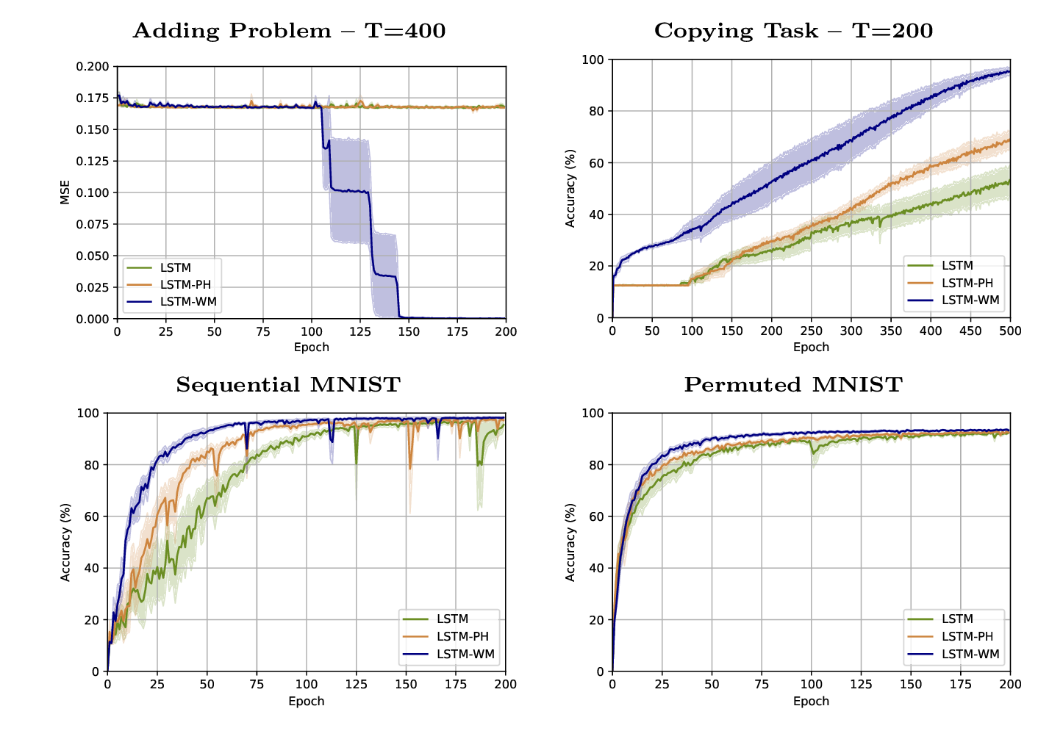
Experimental Results
Faster convergence and better results than traditional and peephole LSTM
Landi, Baraldi, Cornia, Cucchiara. Working Memory Connections for LSTM. In Neural Networks 2021.

Slide 18
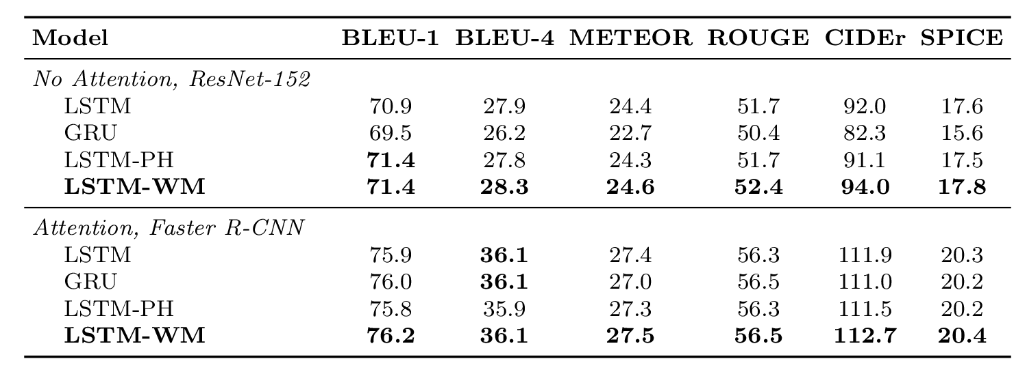
Experimental Results
Penn Treebank: character-level language modeling
MS Coco: image captioning
Landi, Baraldi, Cornia, Cucchiara. Working Memory Connections for LSTM. In Neural Networks 2021.

Slide 19
Research Questions
How to deal with time series with long-term dependencies?
Contribution: Working Memory Connection enhance LSTM performance
How to merge visual perception and actions to enable exploration and simple tasks?
Tools: Modular architectures with hierarchical structures, Deep Reinforcement Learning
How to include natural language in the agent reasoning?
Tools: Multimodal fusion techniques

Slide 20
Research Questions
How to deal with time series with long-term dependencies?
Contribution: Working Memory Connection enhance LSTM performance
How to merge visual perception and actions to enable exploration and simple tasks?
Tools: Modular architectures with hierarchical structures, Deep Reinforcement Learning
How to include natural language in the agent reasoning?
Tools: Multimodal fusion techniques

Slide 21
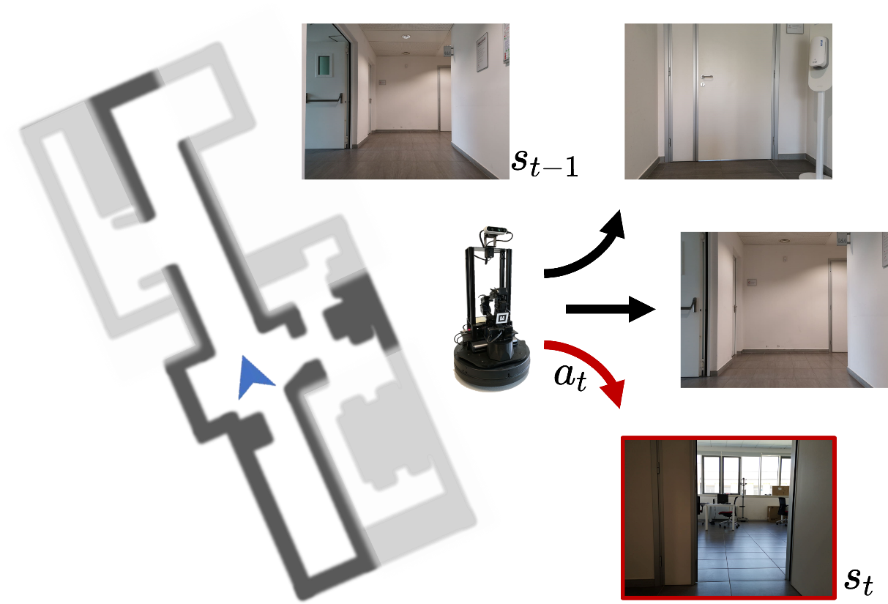
Robotic Exploration
How to improve robotic exploration of indoor photorealistic environments?
In embodied exploration, the agent must:
Navigate towards unexplored areas
Map free and occupied regions
Maximize mapping accuracy and seen area
We devise a DRL-based agent using impact-driven intrinsic reward
Bigazzi, Landi, Cascianelli, Baraldi, Cornia, Cucchiara. Focus on Impact: Indoor Exploration with Intrinsic Motivation. In RA-L 2022.

Slide 22
Focus on Impact
Bigazzi, Landi, Cascianelli, Baraldi, Cornia, Cucchiara. Focus on Impact: Indoor Exploration with Intrinsic Motivation. In RA-L 2022.

Slide 23
Focus on Impact
Impact
Bigazzi, Landi, Cascianelli, Baraldi, Cornia, Cucchiara. Focus on Impact: Indoor Exploration with Intrinsic Motivation. In RA-L 2022.

Slide 24
Focus on Impact
Impact
Visitation counts
Bigazzi, Landi, Cascianelli, Baraldi, Cornia, Cucchiara. Focus on Impact: Indoor Exploration with Intrinsic Motivation. In RA-L 2022.

Slide 25
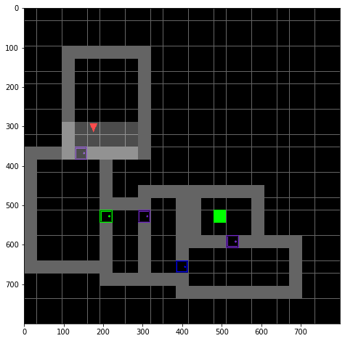
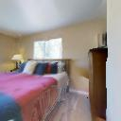
Visitation Counts
Finite number of states
Computing is trivial
Non-countable number of possible states
How to compute ?
Bigazzi, Landi, Cascianelli, Baraldi, Cornia, Cucchiara. Focus on Impact: Indoor Exploration with Intrinsic Motivation. In RA-L 2022.

Slide 26
Visitation Counts
Finite number of states
Computing is trivial
Non-countable number of possible states
How to compute ?
Bigazzi, Landi, Cascianelli, Baraldi, Cornia, Cucchiara. Focus on Impact: Indoor Exploration with Intrinsic Motivation. In RA-L 2022.

Slide 27
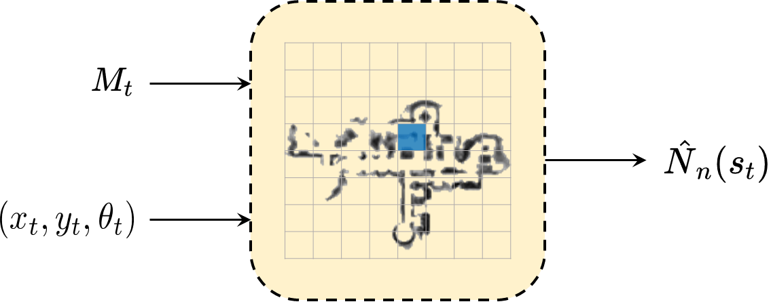
Pseudo Visitation Counts
Grid-based pseudo-counts
Estimated pseudo-counts
Bigazzi, Landi, Cascianelli, Baraldi, Cornia, Cucchiara. Focus on Impact: Indoor Exploration with Intrinsic Motivation. In RA-L 2022.

Slide 28
Pseudo Visitation Counts
Grid-based pseudo-counts
Estimated pseudo-counts
Bigazzi, Landi, Cascianelli, Baraldi, Cornia, Cucchiara. Focus on Impact: Indoor Exploration with Intrinsic Motivation. In RA-L 2022.

Slide 29
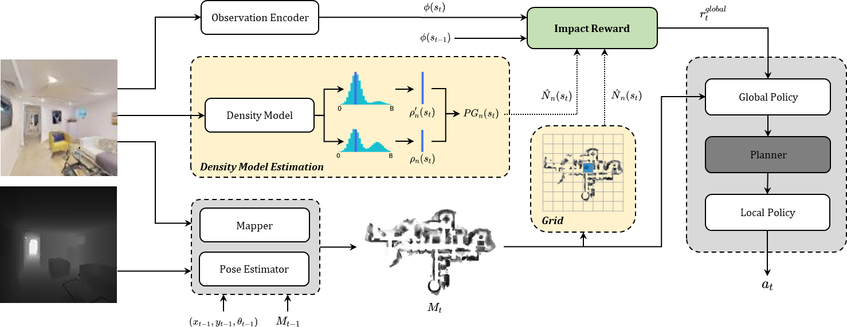
Architecture
We build a hierarchical and modular architecture trained with an Impact-based reward
Bigazzi, Landi, Cascianelli, Baraldi, Cornia, Cucchiara. Focus on Impact: Indoor Exploration with Intrinsic Motivation. In RA-L 2022.

Slide 30
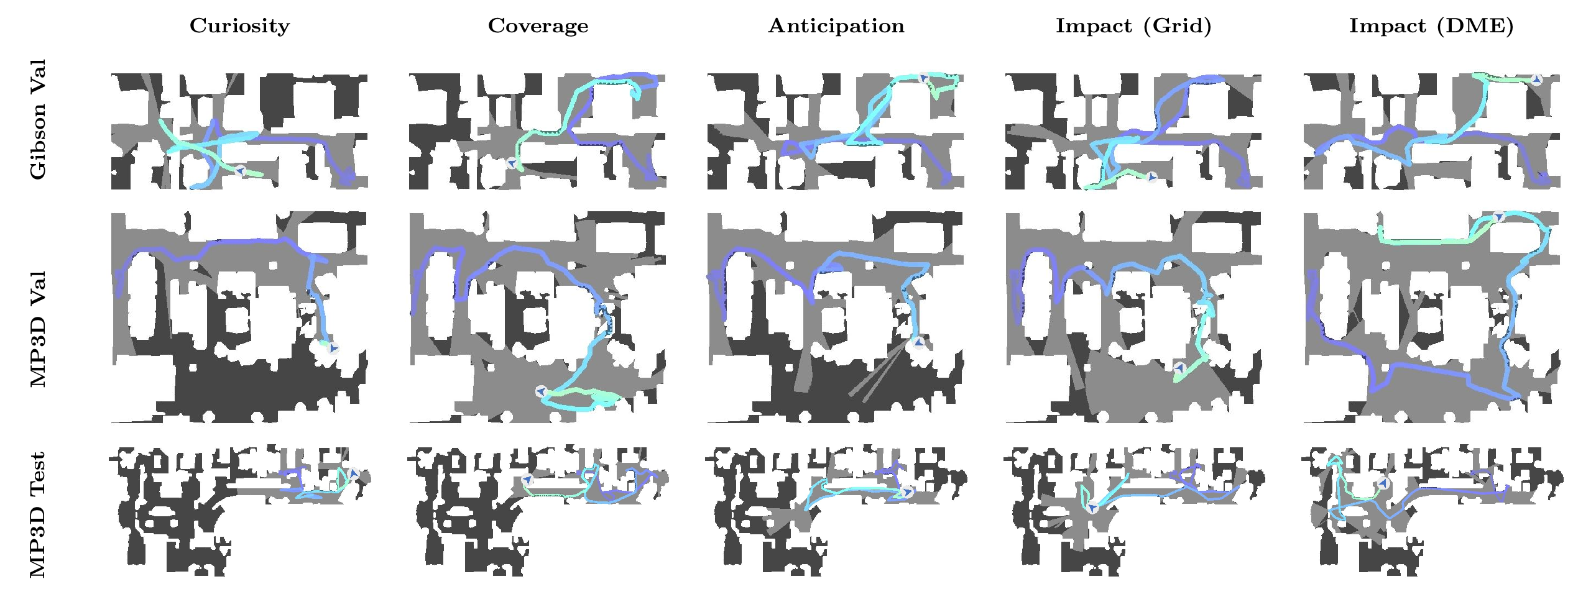
Qualitative Results
Our agents outperforms existing competitors in embodied exploration of indoor environments
Bigazzi, Landi, Cascianelli, Baraldi, Cornia, Cucchiara. Focus on Impact: Indoor Exploration with Intrinsic Motivation. In RA-L 2022.

Slide 31
Quantitative Results
Increased mapping accuracy and area seen on the MatterPort3D dataset
Bigazzi, Landi, Cascianelli, Baraldi, Cornia, Cucchiara. Focus on Impact: Indoor Exploration with Intrinsic Motivation. In RA-L 2022.

Slide 32
Real-world Deployment
Bigazzi, Landi, Cascianelli, Baraldi, Cornia, Cucchiara. Focus on Impact: Indoor Exploration with Intrinsic Motivation. In RA-L 2022.

Slide 33
Research Questions
How to deal with time series with long-term dependencies?
Contribution: Working Memory Connection enhance LSTM performance
How to merge visual perception and actions to enable exploration and simple tasks?
Contribution: New architectures and Tasks, Impact for Indoor Exploration
How to include natural language in the agent reasoning?
Tools: Multimodal fusion techniques

Slide 34
Research Questions
How to deal with time series with long-term dependencies?
Contribution: Working Memory Connection enhance LSTM performance
How to merge visual perception and actions to enable exploration and simple tasks?
Contribution: New architectures and Tasks, Impact for Indoor Exploration
How to include natural language in the agent reasoning?
Tools: Multimodal fusion techniques

Slide 35
Vision-and-Language Navigation (VLN)
VLN is a task in which an agent needs to...
Interpret a previously unseen natural language navigation command in light of images generated by a previously unseen real environment (Anderson et al. CVPR 2018);
Follow a given instruction to navigate from a starting location to a goal location (Fried et al. NeurIPS 2018);
Reach a target location by navigating unseen environments, with a natural language instruction as only clue (Landi et al. BMVC 2019);
…
…
Know where to go!

Slide 36
The Challenge of Multimodality
"Go straight then turn right and pass the many desks until you get to the ping pong table. Wait there."
High-dimensional Representations

Slide 37
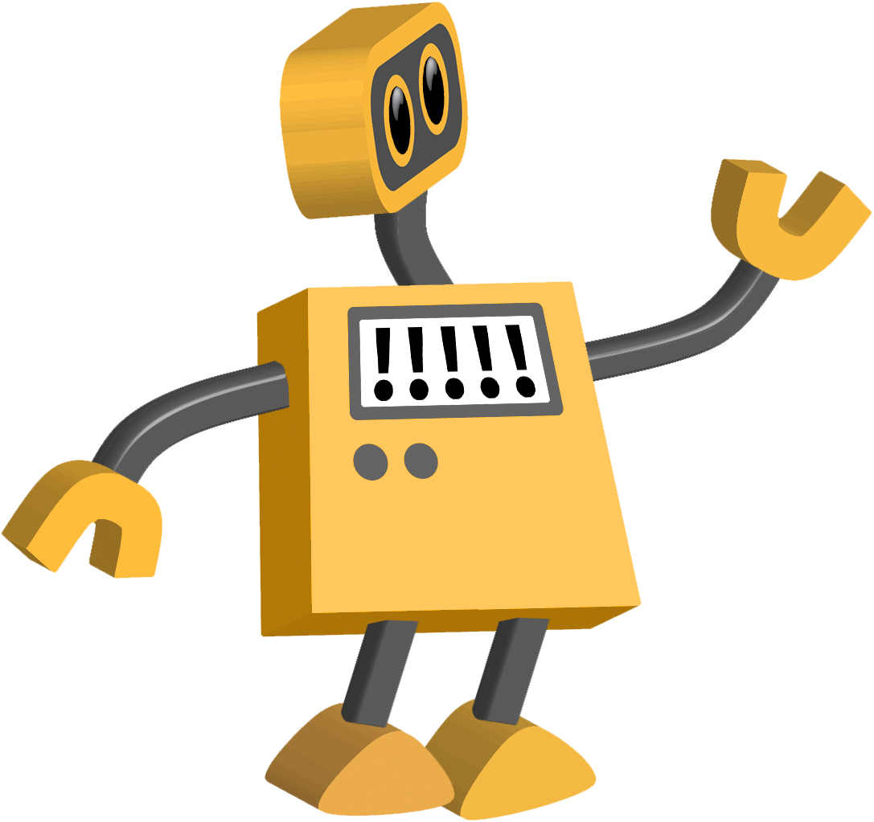
The Challenge of Multimodality
"Go straight then turn right and pass the many desks until you get to the ping pong table. Wait there."
Merged Representation

Slide 38
Dynamic Convolution for VLN
Key idea: use dynamic convolution to merge linguistic and visual information
: representation for the current instruction (time-dependent)
: set of dynamic convolutional filters
Landi, Baraldi, Corsini, Cucchiara. Embodied Vision-and-Language Navigation with Dynamic Convolutional Filters. In BMVC 2019.

Slide 39
Dynamic Convolution for VLN
Instruction:
a) Take a right, going past the kitchen into the hallway
b) Walk into the sitting area and stop before the couch
Landi, Baraldi, Corsini, Cucchiara. Embodied Vision-and-Language Navigation with Dynamic Convolutional Filters. In BMVC 2019.

Slide 40
Dynamic Convolution for VLN
Instruction:
a) Take a right, going past the kitchen into the hallway
b) Walk into the sitting area and stop before the couch
Landi, Baraldi, Corsini, Cucchiara. Embodied Vision-and-Language Navigation with Dynamic Convolutional Filters. In BMVC 2019.

Slide 41
Dynamic Convolution for VLN
Instruction:
a) Take a right, going past the kitchen into the hallway
b) Walk into the sitting area and stop before the couch
Landi, Baraldi, Corsini, Cucchiara. Embodied Vision-and-Language Navigation with Dynamic Convolutional Filters. In BMVC 2019.

Slide 42
Transformer-based Approach to VLN
Motivations:
The RNN internal state must condense:
visual perception where am I?
textual information what’s my goal?
past actions what’s my progress?
across multiple time steps!
Hard to learn – and single point of failure for the whole model
Landi, Baraldi, Cornia, Corsini, Cucchiara. Multi-modal Attention Networks for Low-Level Vision-and-Language Navigation. In CVIU 2021.

Slide 43
Transformer-based Approach to VLN
Our model leaves RNNs behind, and builds upon:
Fully-attentive blocks;
Multiple levels of fusion;
Action history to model time.
First fully-attentive architecture for VLN
Landi, Baraldi, Cornia, Corsini, Cucchiara. Multi-modal Attention Networks for Low-Level Vision-and-Language Navigation. In CVIU 2021.

Slide 44
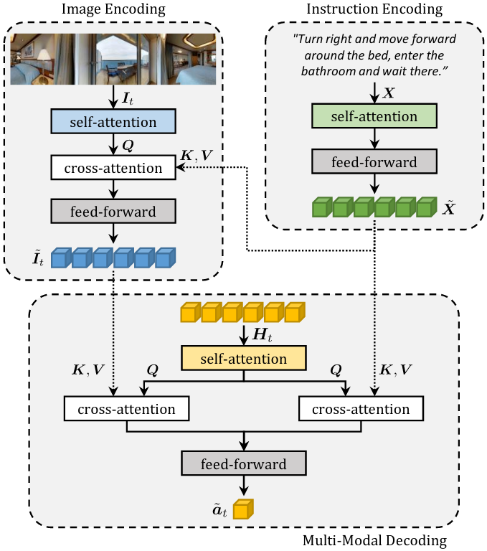
Perceive, Transform, and Act (PTA)
In self-attention layers, the Keys, Queries, and Values
(K, Q, V) come from the same source sequence
Landi, Baraldi, Cornia, Corsini, Cucchiara. Multi-modal Attention Networks for Low-Level Vision-and-Language Navigation. In CVIU 2021.

Slide 45
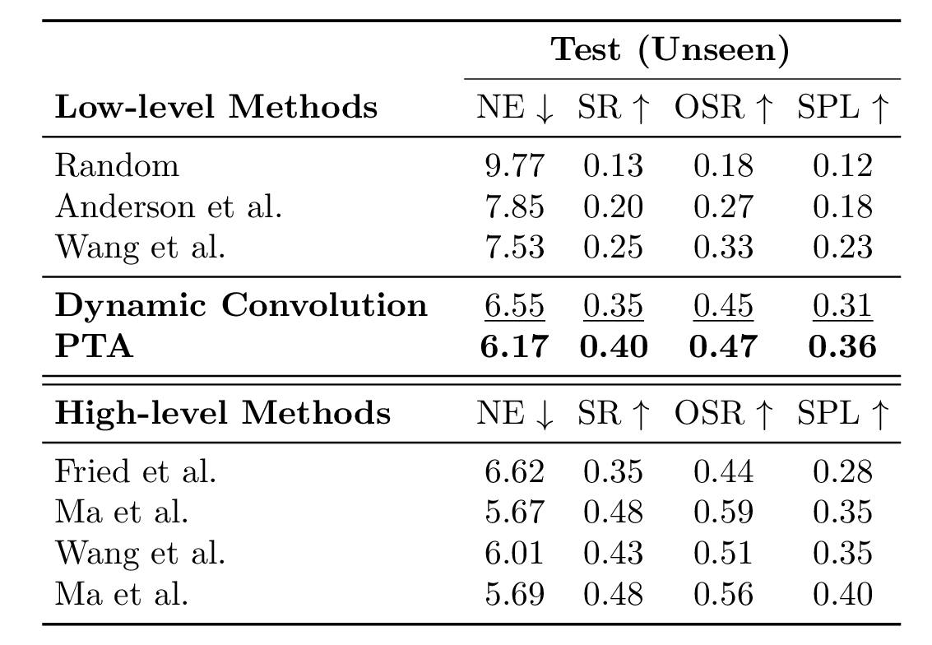
Quantitative Results
Comparison with state-of-the-art methods. The test set is accessible via a public evaluation server
Evaluation Metrics:
NE (Navigation Error)
SR (Success Rate)
OSR (Oracle Success Rate)
SPL (SR weighted by Path Length)
The proposed methods are first and second-best in their own category
Landi, Baraldi, Corsini, Cucchiara. Embodied Vision-and-Language Navigation with Dynamic Convolutional Filters. In BMVC 2019.
Landi, Baraldi, Cornia, Corsini, Cucchiara. Multi-modal Attention Networks for Low-Level Vision-and-Language Navigation. In CVIU 2021.

Slide 46
Quantitative Results
Comparison with state-of-the-art methods. The test set is accessible via a public evaluation server
Evaluation Metrics:
NE (Navigation Error)
SR (Success Rate)
OSR (Oracle Success Rate)
SPL (SR weighted by Path Length)
The proposed methods are first and second-best in their own category
Landi, Baraldi, Corsini, Cucchiara. Embodied Vision-and-Language Navigation with Dynamic Convolutional Filters. In BMVC 2019.
Landi, Baraldi, Cornia, Corsini, Cucchiara. Multi-modal Attention Networks for Low-Level Vision-and-Language Navigation. In CVIU 2021.

Slide 47
Quantitative Results
Comparison with state-of-the-art methods. The test set is accessible via a public evaluation server
Evaluation Metrics:
NE (Navigation Error)
SR (Success Rate)
OSR (Oracle Success Rate)
SPL (SR weighted by Path Length)
The proposed methods are first and second-best in their own category
Landi, Baraldi, Corsini, Cucchiara. Embodied Vision-and-Language Navigation with Dynamic Convolutional Filters. In BMVC 2019.
Landi, Baraldi, Cornia, Corsini, Cucchiara. Multi-modal Attention Networks for Low-Level Vision-and-Language Navigation. In CVIU 2021.

Slide 48
Research Questions
How to deal with time series with long-term dependencies?
Contribution: Working Memory Connection enhance LSTM performance
How to merge visual perception and actions to enable exploration and simple tasks?
Contribution: New architectures and Tasks, Impact for Indoor Exploration
How to include natural language in the agent reasoning?
Contribution: Dynamic Convolution and Fully-Attentive Architecture for VLN

Slide 49
Conclusion
Embodied AI is a new and very active research area that will experience radical improvements:

Slide 50
Conclusion
Embodied AI is a new and very active research area that will experience radical improvements:
New architectures able to deal with long-term dependencies and multimodality

Slide 51
Conclusion
Embodied AI is a new and very active research area that will experience radical improvements:
New architectures able to deal with long-term dependencies and multimodality
More data, more tasks, more efficient simulating platforms

Slide 52
Conclusion
Embodied AI is a new and very active research area that will experience radical improvements:
New architectures able to deal with long-term dependencies and multimodality
More data, more tasks, more efficient simulating platforms
Standardization, common settings and metrics, shared objectives

Slide 53
Conclusion
Embodied AI is a new and very active research area that will experience radical improvements:
New architectures able to deal with long-term dependencies and multimodality
More data, more tasks, more efficient simulating platforms
Standardization, common settings and metrics, shared objectives
Thank you!
federico.landi@unimore.it

Slide 54
List of Publications
Focus on Impact: Indoor Exploration with Intrinsic Motivation. Roberto Bigazzi, Federico Landi, Silvia Cascianelli, Lorenzo Baraldi, Marcella Cornia, Rita Cucchiara. RA-L 2022.
Working Memory Connections for LSTM. Federico Landi, Lorenzo Baraldi, Marcella Cornia, Rita Cucchiara. NEUNET 2021.
Multimodal Attention Networks for Low-Level Vision-and-Language Navigation. Federico Landi, Lorenzo Baraldi, Marcella Cornia, Massimiliano Corsini, Rita Cucchiara. CVIU 2021.
Out of the Box: Embodied Navigation in the Real World. Roberto Bigazzi, Federico Landi, Marcella Cornia, Silvia Cascianelli, Lorenzo Baraldi, Rita Cucchiara. CAIP 2021.
Transform, Warp, and Dress: A New Transformation-Guided Model for Virtual Try-On. Matteo Fincato, Marcella Cornia, Federico Landi, Fabio Cesari, Rita Cucchiara. TOMM 2021.
VITON-GT: An Image-based Virtual Try-On Model with Geometric Transformations. Matteo Fincato, Federico Landi, Marcella Cornia, Fabio Cesari, Rita Cucchiara. ICPR 2020.
Explore and Explain: Self-supervised Navigation and Recounting. Roberto Bigazzi, Federico Landi, Marcella Cornia, Silvia Cascianelli, Lorenzo Baraldi, Rita Cucchiara. ICPR 2020.
Embodied Vision-and-Language Navigation with Dynamic Convolutional Filters. Federico Landi, Lorenzo Baraldi, Massimiliano Corsini, Rita Cucchiara. BMVC 2019.
Thank you!
federico.landi@unimore.it

